Slide 1
Predicting Movie Performance
William Lees IV (wjl2128)
Implementation of Machine learning and linear regression
PROGRESS
11/22/2021

Slide 2
Problems and Setbacks
Imbd API did not contain Ranking data
Web scraped html meta data as solution
Twitter API limited historical data to 7 days
Changed design to pull comments from youtube trailors
Youtube API limits number of comments pulled
API was only used to to pull youtube codes for videos
Youtube web pages uses Java based code source not suited for BeautifulSoup
Google chrome selenium libraries used to parse youtube comments
11/22/2021
William Lees IV (wjl2128)

Slide 3
Methods Used
Youtube API
Needed two keys to pull all data for 154 movie trailer links
Pandas
Used to manipulate and append CSV data
Urllib, Beautiful Soup
HTML Parsing for movie ranking (imbd ranks)
Selenium:google chrome
Useful google chrome python library to pull youtube java script data (comments)
Pyspark Linear Regression ML libraries (future)
Vectorizer (future)
11/22/2021
William Lees IV (wjl2128)

Slide 4
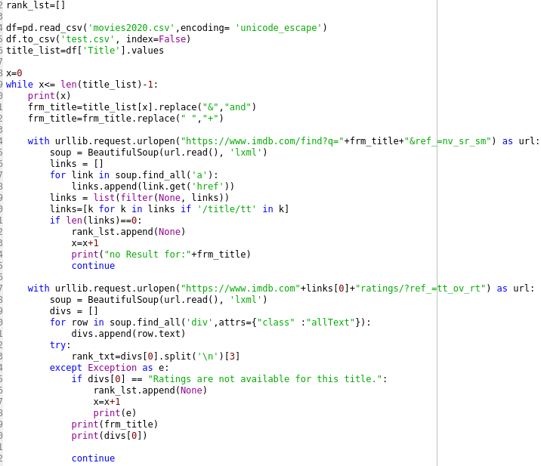
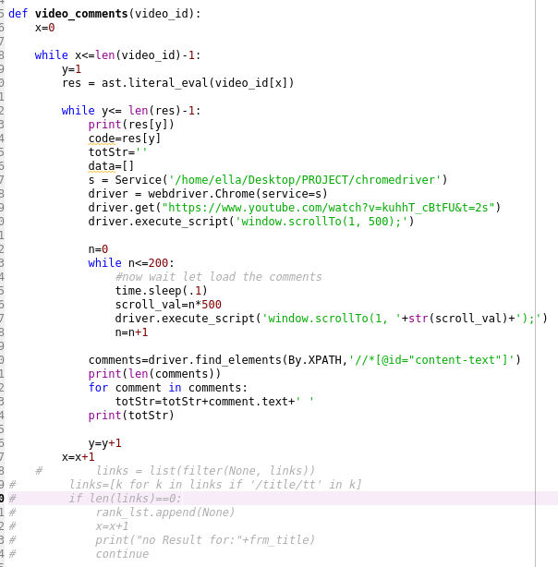
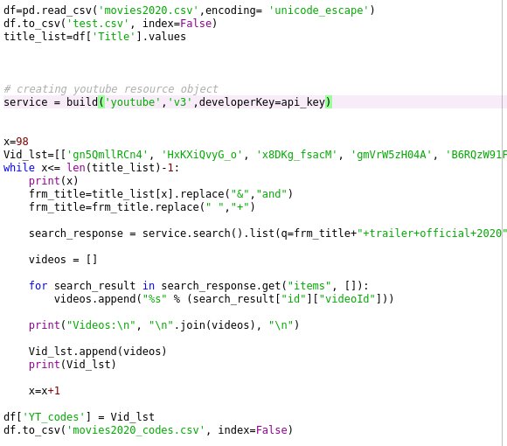
Project flow and progress
movies2020.csv
CSV_IMBD.py
movies2020_ratings.csv
CSV_Codes.py
movies2020_codes.csv
Word_ranker.py
11/22/2021
William Lees IV (wjl2128)

Slide 5
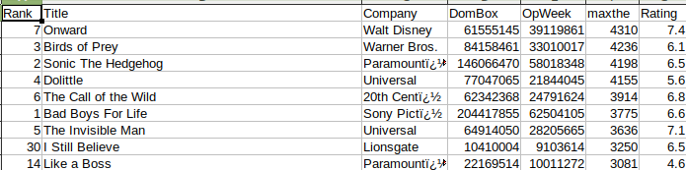
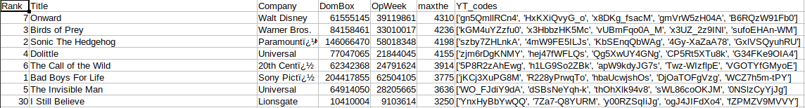
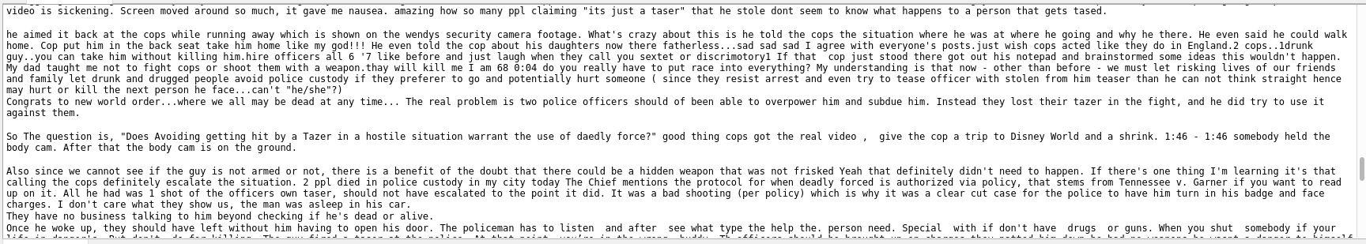
CSV Results
movies2020_ratings.csv
movies2020_codes.csv
Comments for first video
11/22/2021
William Lees IV (wjl2128)

Slide 6
Evaluation and Analysis
Testing Dual linear regression models
70% learning data
30% test data
If linear regression provides poor results other ML models will be considered
Full evaluation of accuracy models will be evaluated if needed
Youtube API issues
One of the major setbacks to robust code is the limitiations to the youtube API
Work Arounds
HTML parsing and Js scraping both provide robust solutions to data cap limits
Future vidsual analysis
Data will be crossreference
Keyword corolation analysis will be performed
11/22/2021
William Lees IV (wjl2128)

Slide 7
Schedule
Task | Estimated Date Completion
Establish TCP connection to Twitter API | 11/12/2021
Pull IMDb data and append it to movie dataset | 11/12/2021
2020 Data formatting and Twitter ranking | 11/19/2021
Training Linear regression models | 11/22/2021
2022 Data formatting and Twitter ranking | 11/22/2021
Run Linear regression tests | 11/26/2021
Data analysis and visualization | 12/10/2021
Cross correlation data analysis | TBD: If time permits
11/22/2021
William Lees IV (wjl2128)

